Slide 1

iOS Dev Scout Singapore, October 2018
Notes:
Hello everyone. Welcome to iOS dev scout October 2018.
Today in my talk, I would like to introduce to you one way that can potentially raise up the product revenue. And it means you will have more bonus, your family will be more happy. Just kidding.
Before we start, I wanna briefly introduce about myself.

Slide 2

Thanh
Software Engineer
Rakuten Viki
linkedin.com/in/thanhturin/
thanhturin@gmail.com
Notes:
My name is Thanh
I’m currently an iOS developer at Rakuten Viki, an Asian Drama Streaming Platform.
Once again, thanks Lizzie for her recent introduction.
You can find more information about me by visit my home page on linkedin.
And if you have any question or anything unclear about my talk, please don’t hesitate to send a message to my email thanhturin@gmail.com

Slide 3



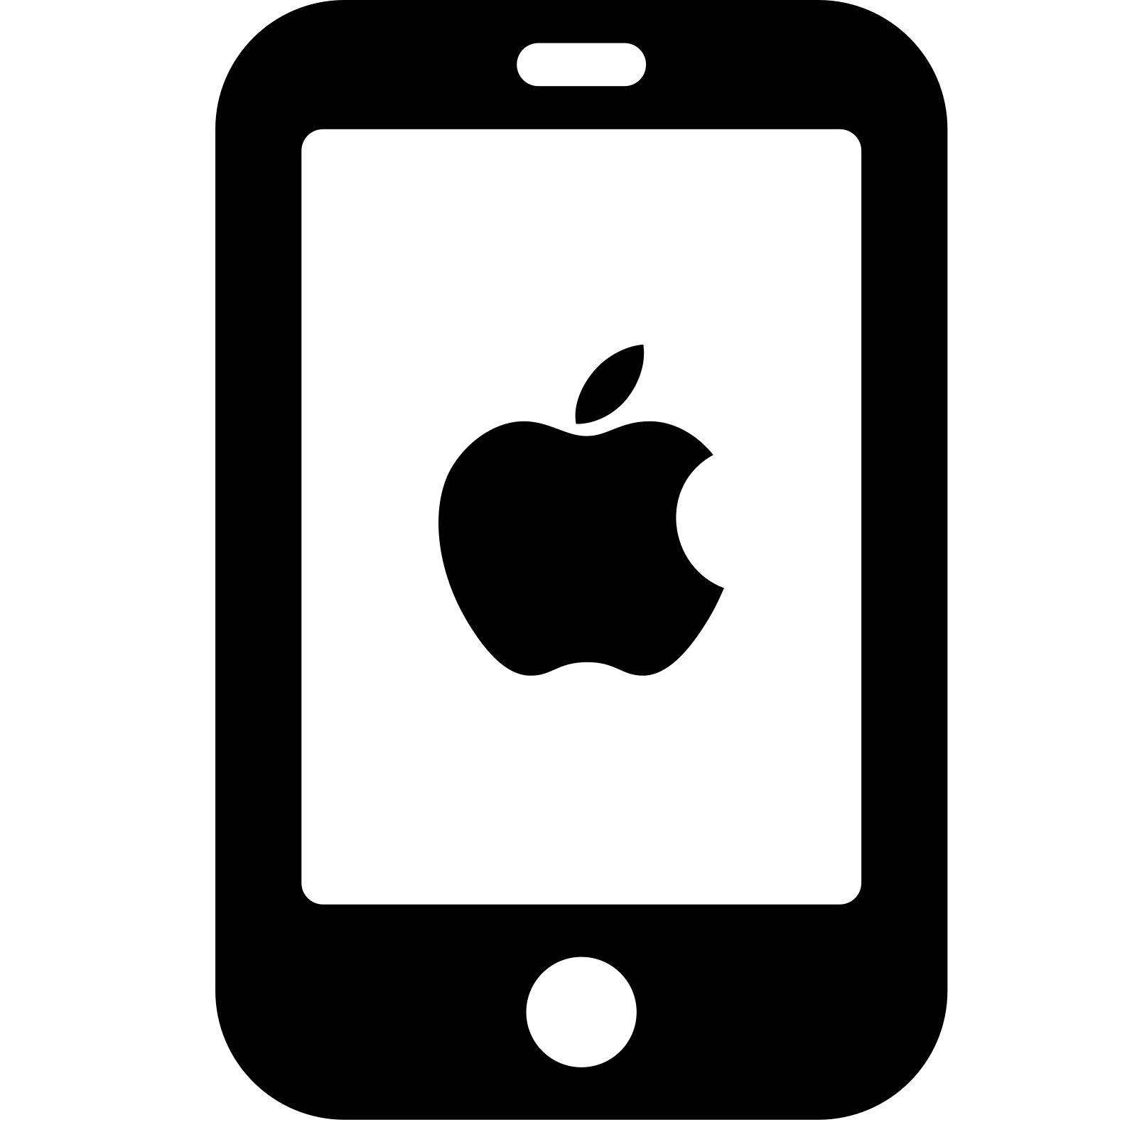





“People who are really serious about software should make their own hardware”
Alan Kay
Notes:
An apple with a missing piece. The logo of one of the most successful company in the world.
Most of us here are iOS developers and I think you are be familiar with Apple eco system (if don’t wanna say you are all experts)
We are using Apple products everyday
We use Macbook for working
iPhone for communication and entertainment
We use Apple Watch for tracking our health
I don’t know your feeling about Apple products but I really love it. This is one of the reason make me become an iOS developer.
The truth is I have not seen any iOS developers use Android phone but I saw many Android developers around me are using iPhone
Even they work for the rival with iOS, they still decide to use it.
So what does it mean? It means Apple has built a successful eco system.
Steve Job on Apple event 2007, before introducing iPhone, he said “people who are, …” and so far Apple is stilling operating with this mindset
When they build a hardware device, they don’t leave it alone, but make an operation system for it which will bring the best experiment to user
And make it compatible with all of other devices from Apple. It is just pretty impressive.
Today I wanna talk about one of the child in Apple family, this is a hardware device, which also has it own operation system
This is a device looks like a mac mini, but runs on an operation system very close to iOS
And the device I’m mentioning is Apple TV
And the talk I will give today is “Developing for Apple TV”

Slide 4
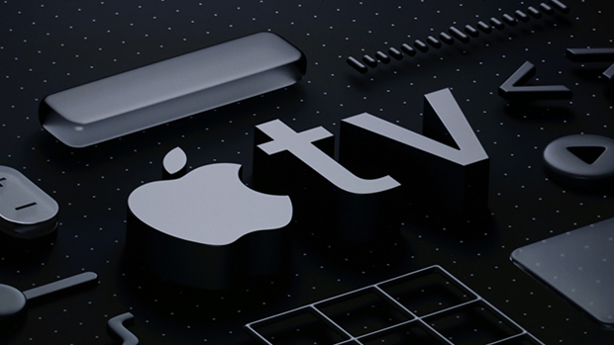
Developing For Apple TV
Notes:
Why do we should implement Apple TV app:
First, Apple users always spend more than other platforms users.
It makes sense because usually Apple devices are more expensive
And people who adapt to buy it for entertainment are very potential to pay for our service...
Show how grows it is on number of Apple TV sold…
From 5m in 2012 to 25m in 2015 and 75m in 2017
More and more support, better device, better user experiences…
User feedback about experience while using tv app compare with phone app
Last but not least, It does not cost much to keep building and maintaining tvOS app. You wanna see how easy is it. I will show you right now.

Slide 5

Agenda
Apple TV and tvOS
Developing for Apple TV
Demo
Notes:
Agenda today I will break my talk into 3 separate sections
First, I will briefly introduce about Apple TV and tvOS
Then I will talk about fundamental thing when building Apple TV App
After than I will give you a demo of building a small app which supports for both iOS and tvOS
And finally I will try to implement with you a small feature to enhance how easy it is to maintain the app

Slide 6
Apple TV & tvOS
Notes:
SO okay. let’s quick start with Apple TV and tvOS introduction

Slide 7
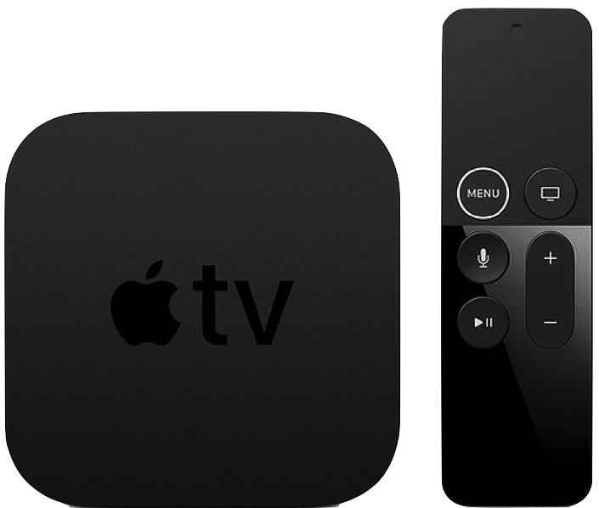
Apple TV 4K
5th Gen (2017)
Notes:
Apple TV is a digital media player device. It can collect data from internet by Wifi. And to use it for viewing, you have to connect it with a TV via HDMI cable. Apple TV, as I introduced before, runs on tvOS, and the latest tvOS is tvOS 12.
On the screen is the latest Apple TV release, Apple TV 4K, the 5th gen. It was launched last year. For CPU, It’s using Apple A10 and the price for highest specs is about 300 SGD
For more precisely, The square one on the left hand side is Apple TV.
As you can see it has no integrated controls, therefore it can only be interacted externally. Apple provide several ways to communicate with Apple TV.
By default, when you buy an Apple TV, inside the box, there will be a controller, which Apple calls it Siri Remote. And it will use Bluetooth to compare with Apple TV.
They call it Siri Remote because you can use your voice to control it by Siri assistance
Furthermore you also can use your iPhone to control Apple TV. This is something very awesome from Apple. Everything can be compatible perfectly
If you have not tried it yet Please give it a try. we are putting some devices on the back shelf.

Slide 8
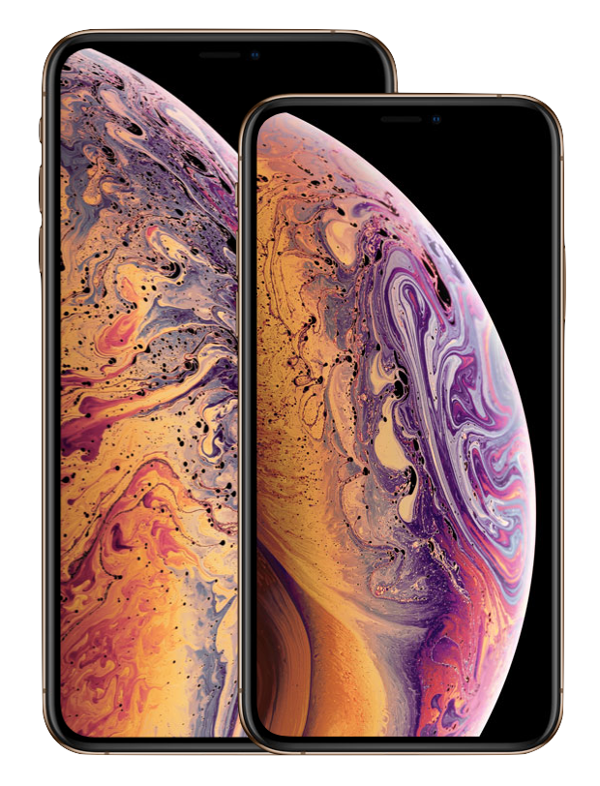
Notes:
So right now the latest Apple TV is the 5th generation, meanwhile the latest iPhone is XS, which one do you think is older than the other one, Apple TV or iPhone?

Slide 9

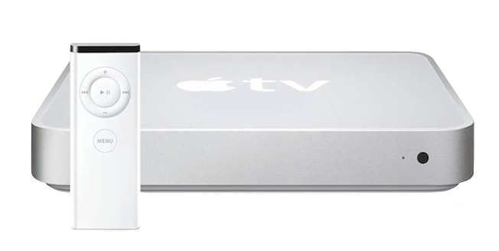
2007: iPhone 1st Gen
2006: Apple TV 1st Gen
Notes:
The first iPhone was introduced in the historical Apple Event 2007 by Steve Jobs, and it changed the phone industry forever
Before iPhone, nothing looks like an iPhone, after iPhone, every phone looks like iPhone
But do you know one year before it, Apple also announce another new device.
This is the Apple TV 1st Gen
But at this time, they have a different name for it
Here I have a gift for you if you can guess the correct name for it (iTV)
A name with a similar concept with other devices on Apple eco system
I will have a hint, iPhone, iPod, iPad, …
That iTV box looks very close to Mac Mini
Actually it runs on MacOS X 10.3.9, so you can think this is another version of Mac mini
Except it has the controller and can not connect to keyboard or mouse
CPU: Intel Pentium

Slide 10
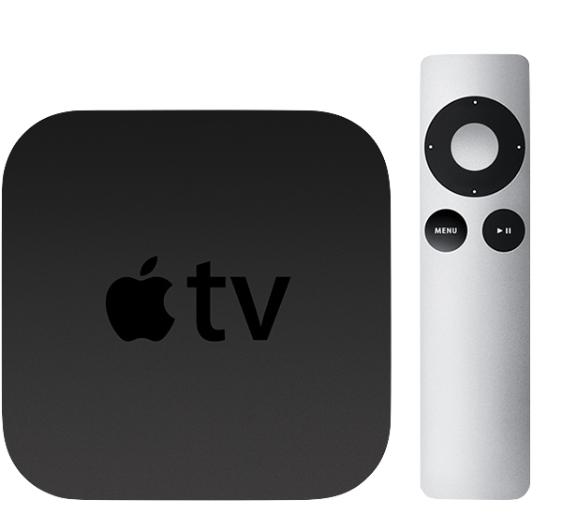
Apple TV 2nd Gen (2010)
Notes:
It takes 4 years to have the second generation of Apple TV
After the success of the first iPhone, Apple focused 100% on enhancing iOS eco system
They make iPod runs on iOS, as well as introduce iPad which runs on iOS as well
And 4 years since the first announcement
In 2010 Apple redesign iTV and introduce the secondary generation.
This is a huge refactoring on iTV
The new version has a completely new design
From this version, Apple decided to use the name Apple TV instead of iTV as previously
It does not run on Mac OS anymore, and instead, it runs on iOS
Yes, it's iOS, Until end of 2010 Apple introduced tvOS 9 which is 95% bases on iOS 9
And since there Apple TV will only run on tvOS

Slide 11
Apple TV sold
Notes:
75 millions is a huge number because Apple TV is a shared device, unlike iPhone is individual. So usually we only one Apple TV per family.
Easy for imagining, Apple TV is now taking 18% of the whole world TV box market (beside Apple TV is Android TV, Xiaomi TV, Roku TV,…), which is the second largest in the world
If you look at the chart, Apple TV is growing up very rapidly. TV is a better choice for a sharing group than phone. Like family time, or friends time.
Today I’m gonna talk about tvOS and how to implement it on scratch or in an iOS application which is already built and already working
To make it easier to imagine, there are 1.2b iPhone + … meanwhile only have 75m Apple TV in end of 2017. (quite humble?)
(1.2b iPhone + 0.3b iPad + 0.5b iPod)
Look at the chart we can see the increasement is significant
And we can hope about the wider market will come in the soon future
In 2016 there are 8k apps for tvOS (2k is game)

Slide 12
Notes:
- Initially, I thought Apple TV is only suitable for video streaming or for gaming app
- But I was wrong. There are many kind of apps on Apple TV more than that.
- Airbnb is a great example for this. Imagine your family, or your friend group is going for a vacation trip. Using Airbnb app on Apple TV make you more easily to discuss and pick the best place for everyone. Because we all can see the picture on TV, not like on the phone. And the big picture on TV is absolutely more attractive than the small one on the phone. It shall be the point make you book a room immediately. Compare with their rival which does not have app on TV, they are losing this huge number of users
- This is an app about Flight, Weather Forecast, Dropbox, AMAZON, TINDER, Grubhub
- I think creativity is unlimited, if you wanna expand your market, and to bring the best support for your user, just think thoroughly, you shall find an idea to build an app on Apple TV for your product to gain more user, and also to gain more money.
- Keep in your mind that, user who willingly spend money to buy Apple TV for entertainment is very potential to pay for your service
- And the cost to building and maintaing an app on Apple TV is not much. Especially if you already have one on iOS. So right now i will show you how easy it is to do that
Why do we should implement Apple TV app:
First, Apple users always spend more than other platforms users.
It makes sense because usually Apple devices are more expensive
Show how grows it is on number of Apple TV sold…
From 5m in 2012 to 25m in 2015 and 75m in 2017
More and more support, better device, better user experiences…
User feedback about experience while using tv app compare with phone app
Last but not least, It does not cost much to keep building and maintaining tvOS app. You wanna see how easy is it. I will show you right now.

Slide 13
tvOS app
Custom app
Using same frameworks with native iOS
Client-Server app
Using TVML, TVJS, TVMLKit
Notes:
Apple provides 2 ways to make Apple TV app.
First is the custom app, The process for creating the app is similar with for creating iOS apps. You use the same techniques, same frameworks, same concepts you know when developing iOS app like Storyboards, UIKit, and Auto Layout.
The other one is client-server app which will use TVML, TVJS and TVMLKit to make the app. I will explain for you these 3 abbriviation

Slide 14
TVML
TVML (Television Markup Language) is a form of XML
Apple provides dozens of TVML premade templates
TVJS (Television JavaScript) is a set of JavaScript APIs which provide the means to display apps created with TVML
TVMLKit is a framework which will bridge the gap between native code and TVML, Javascript code.
Notes:
Apple provides dozens of TVML premade templates which is designed to help you can easily display information in a specific way. In a Few slides later I will show you an example of a TVML template
It’s a framework that communicates between TVML, JavaScript, and your native tvOS application
By using TVMLKit to can get any item on the screen, such as View or ViewController by element id and can override the implementation of it.

Slide 15
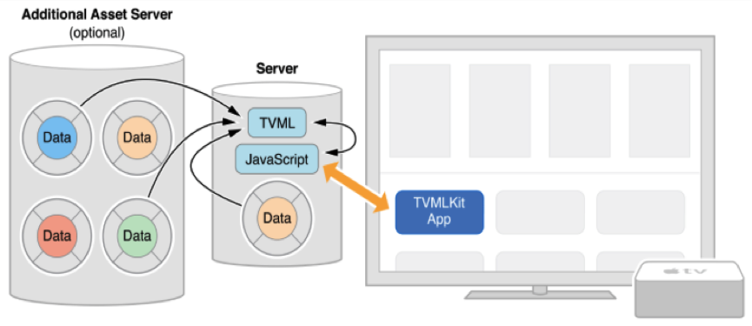
HOW IT WORKS?
Notes:
Unlike custom app, most of the logic and the layout code in TVML app is not compiled to binary file. It stead we need put it on a server. And we define the server URL in AppDelegate, when the app launches, it will use your provided URL to fetch TVML code and run the app base on it

Slide 16
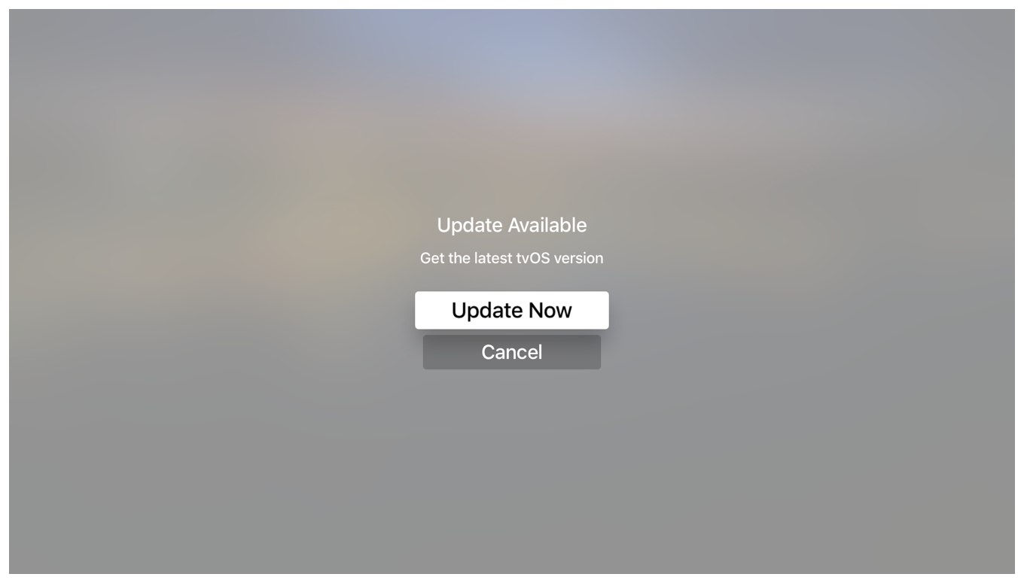
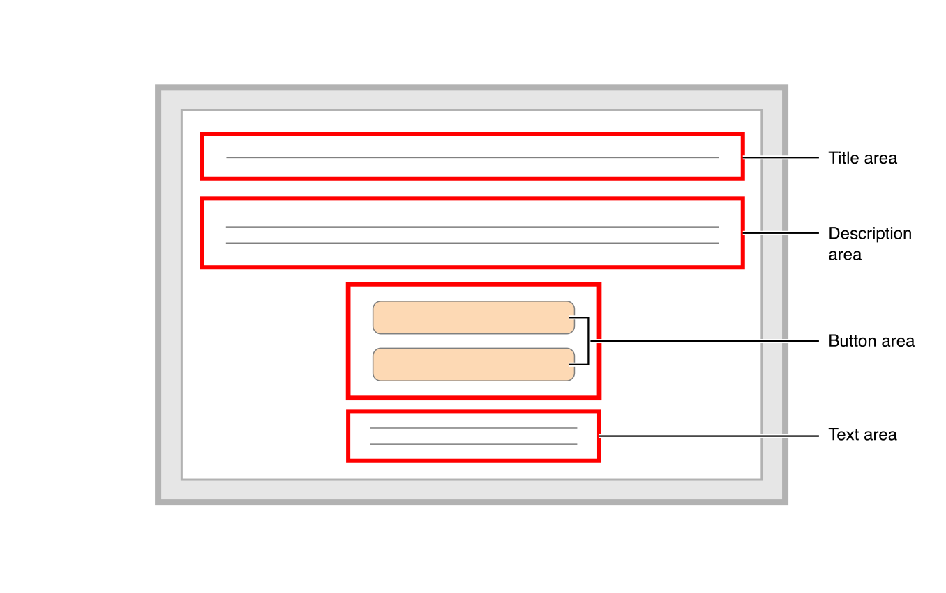
TVML Template Example
Notes:
Let's look at a simple TVML template example
On your left hand side is the alert view on Apple TV
On your right hand side is the premade template
Look at them side by side you can easily link the element on the template to the element on the view. like the Title area will be the first line, and follow by description, and buttons, etc

Slide 17
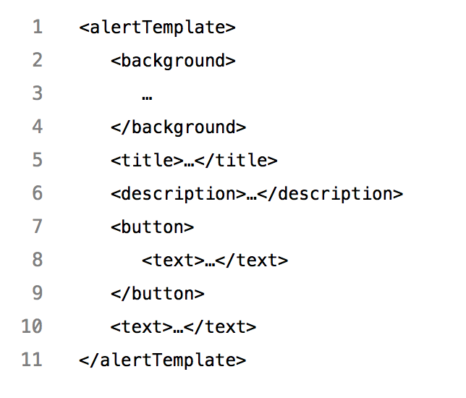
TVML Template Example
Notes:
And so here is how the TVML template code look like
If you use XML, HTML before you will not be so strange with it

Slide 18
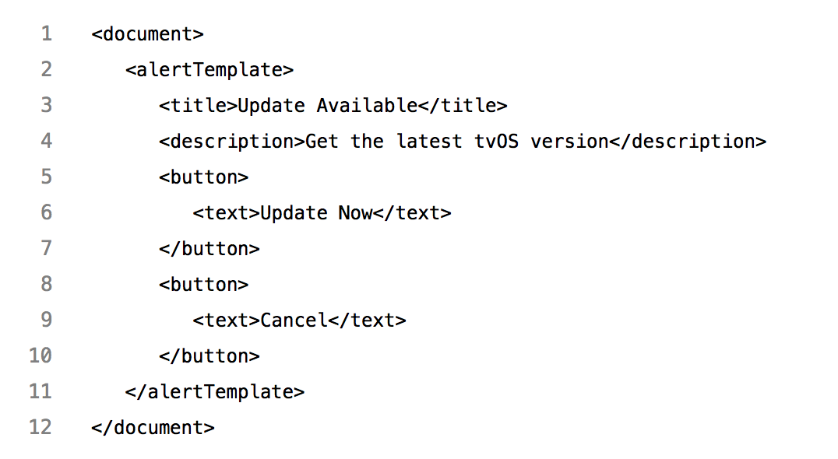
TVML Template Example
Notes:
And finally after filling data to the template you will get the view you expect
Like here i put "Update available" for title field,
"Get the latest tvOS version" for description field,
and so on we will have the view on the right hand side
This is a very simple template. But as i mention above, there are dozens of the premade templates from Apple.

Slide 19
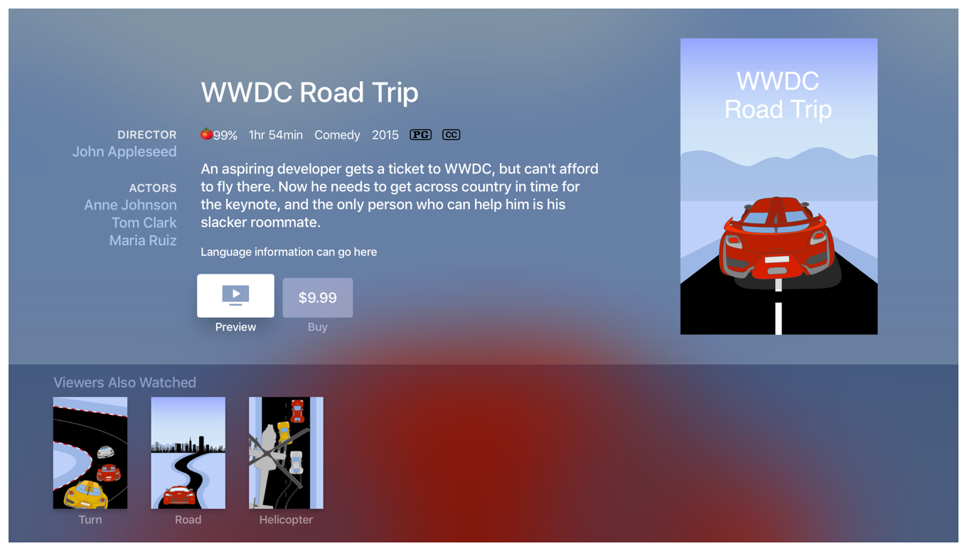
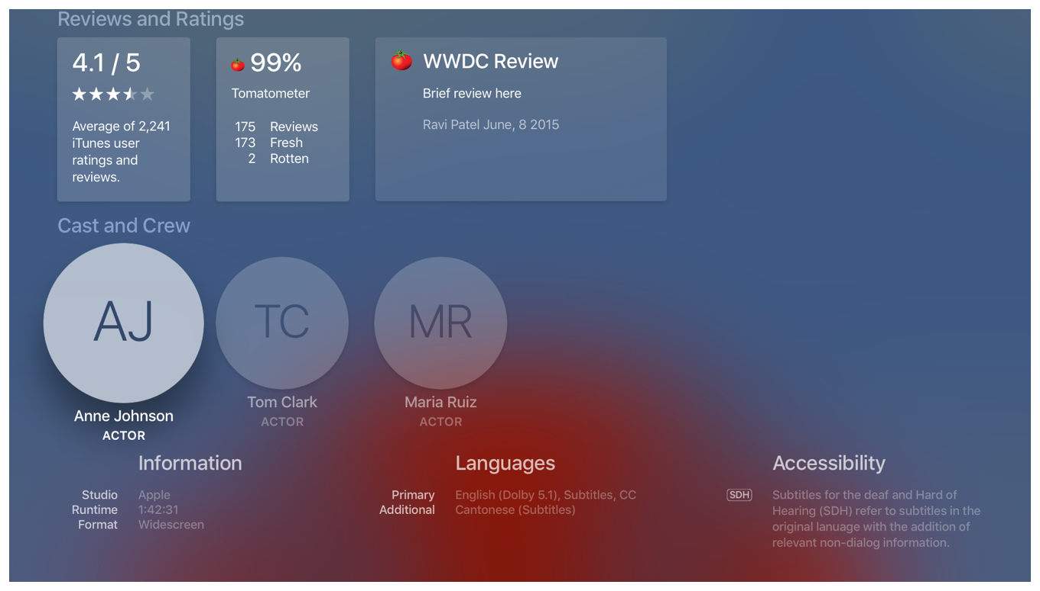
TVML Complicated Template
Notes:
Even for the complicated form like this.
This is a long page.
I slip it into 2 images to make it easier to see
On the left hand is the front, and the one on the right is the back
It has a very complicated layout and imagine how much it will cost you to implement on custom app
You will need to set a lot of layout constraints, collectionview data source, and the shadow and blur background here you also need to handle it thoroughly

Slide 20
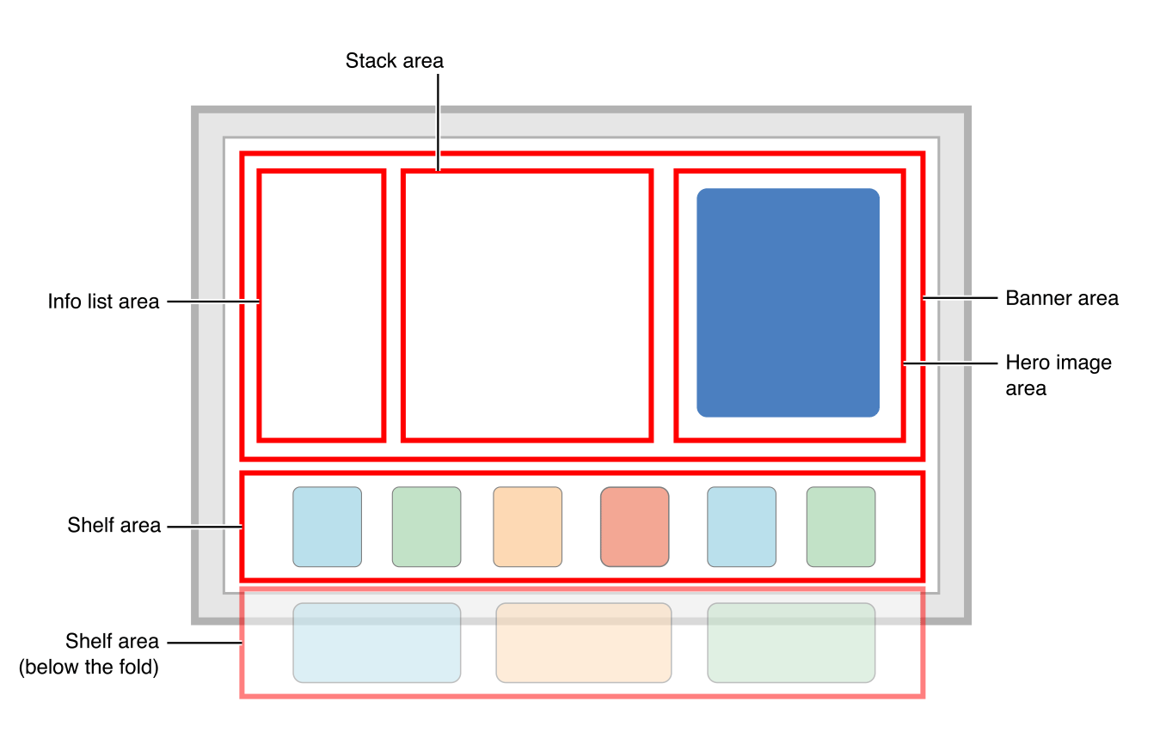
Notes:
On TVML, they make a template for this, and you can just simply fill in data you wanna display, and TVJS it will render it for you automatically

Slide 21
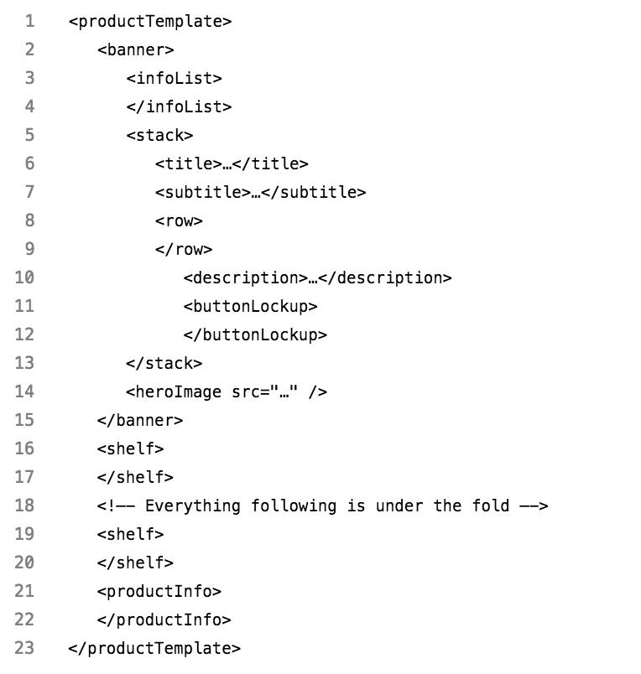
TVML Complicated Template
Notes:
And this is how the template code look like
You can compare the layout with the diagram, and the diagram with the template code
Then fill in the data you wanna display
It can save you lots of time
And there are over 20 templates like this. You can find more on

Slide 22
COMPARISION
Custom App | TVML App
Cocoa framework | TVML, TVJS, TVMLKit
Similar to native iOS | Similar to React Native
Swift, Objective-C | Javascript
Hard to make, easy to maintain | Easy to make, hard to maintain
Suitable with customizing app | Suitable with simple template app
Notes:
So depends on your purpose you can find a good way to implement your tvOS app.
Because for every business we always want to make an app testable, maintainable, scalable
But for us here in Viki, we have implemented our Apple TV app in both ways. And with our experience I would recommend you to make a custom app instead.
Not all of UI has a template for it
By using custom app we can reuse a lot of logic code
It’s hard to maintain (GDPR) by some reason
In short:
Make a TVML App if you primarily provide menus of content, especially if you already have a server set up.
Make a Custom App if you’re aiming to provide a fully immersive experience in your app, where your users will be spending more time interacting with your interface than passively watching or listening to content.
TVML use JS which is not the native programming language for Apple eco system
It will make the code is not shared with iOS app
And need to ramp up
Debug:
Custom App: Can use break point
TVML App: Don’t need recompile

Slide 23
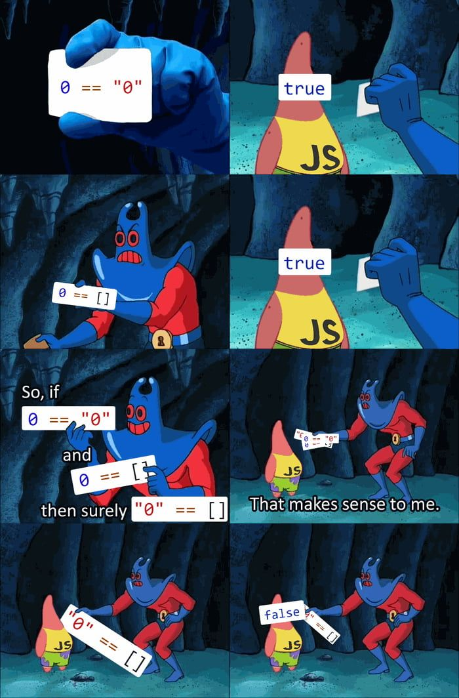

vs
Notes:
And just for my feeling, I am much more comfortable to work on Swift than on JavaScript

Slide 24
Developing Custom Apple TV App On iOS Project

Slide 25
Project structure
UI
User Interface, User Action Handler
Business Logic
API Service, Deep Link, Analytics, Calculation, etc
Third Party Libraries
Install from CocoaPods, Carthage or import Framework directly
Core Framework
Foundation, UIKit, CoreData, etc
Notes:
For any project, we can basically split it into 4 different layers
At the bottom is Core framework such as Foundation, UIKit, CoreData, CoreLocation, …
They are very fundamental and general.
Then we need to use some 3rd party libraries which is built on top of Core Framework for more specific purpose.
You can install them from Cocoa Pod, Carthage, or download and add the framework sdk directly
These two first layers are very basic and available for all the app. We use them as the ingredient to make our app
The next layer is business logic.
This layer contains some services like API Service to communicate with server, or Payment Service, or Location Service, etc.
Beside that it also has deep link handler to control Push Notification or to support universal link
Analytics logger for tracking data
And some calculation if needed…
In reality, you can device business logic to smaller layer. It’s up to the design pattern you choose
The top one is UI layer.
It is responsible to display the app content to user
As well as to receive user action
And ask logic layer for data or for some calculation and depends on the result to response back to user
Our aim is to build up Apple TV app with the least cost. So we will try to reuse as much as possible, and avoid to repeating the code. Look at the diagram, let’s see what can we reuse in the app

Slide 26
Reusability
UI
Very little, Only for base classes
Business Logic
Most of them, as well as the feature is adaptable on the device
Authentication logic, Payment logic, API Service logic, etc
Third Party Libraries
Most of them, except libraries from unsupported framework
Including RxSwift, Alamofire, SwiftyJSON, Crashlytics, etc
Core Framework
Most of them unless the device does not support
WebKit, BiometricKit on iOS <> TVUIKit, TVServices on tvOS
Notes:
Core Framework
Most of the frameworks are available on both iOS and tvOS, like Foundation, UIKit, etc
But for some reason, still have some frameworks only support for a particular platform
BiometricKit is only available on iOS because so far Apple TV does not have TouchId or FaceId for authentication purpose. Hopefully they can add it to Siri Remote in a near future
WebKit is another framework which supports for iOS only because Apple TV does not use Web.
Meanwhile TVUIKit is only for tvOS, it has some UI elements specifically design for Apple TV. And TVServices is for some services only available on AppleTV like TopShelf
Third Party Libraries
Because 3rd party libs is built on top of Core Framework. So most of them are available on both platforms.
The good news is, RxSwift is also available on tvOS
Beside that, a lot of other well known framework, such as Alamofire or AFNetworking, SwiftyJSON, … support for tvOS as well
Business Logic
We build the app by feature.
Ideally all of features which are available on both platforms would be shareable
Like authentication, API Service, Payment Service
UI
Because of the difference between iOS devices and Apple TV, most of the UI code is not reusable, unless it’s very basic. Like you create a UILabel which will show Read More if it’s too long, and tap on it to display the whole text content
So unless we split UI code and Logic code separately, we don’t need to do many things to have Apple TV app.
Morever, Isolating Logic code to UI code not only make your project more organized but also make it more testable. So I really encourage you to split them out.
I have talk about it too much. Let’s start with a Demo. I will show you in reality.

Slide 27
Demo

Slide 28
Notes

Slide 29
Fastlane
Fastlane is not supporting tvOS officially
Using platform tvos to define lane
Notes:
@default = [:ios, :mac, :android]
https://github.com/fastlane/fastlane/blob/master/fastlane/lib/fastlane/supported_platforms.rb

Slide 30
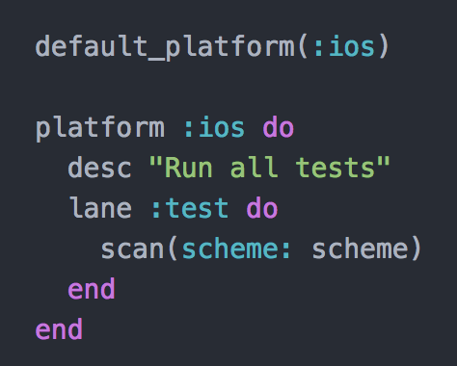

Slide 31
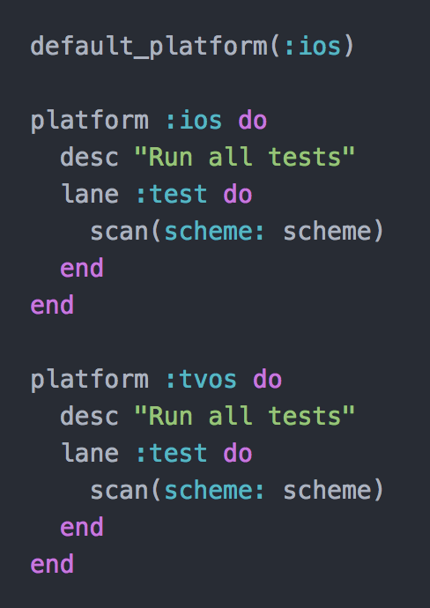

Slide 32
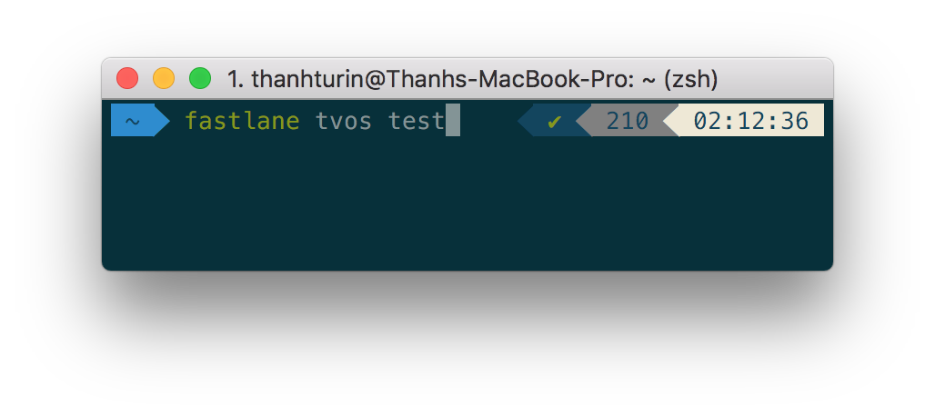


Run fastlane

Slide 33
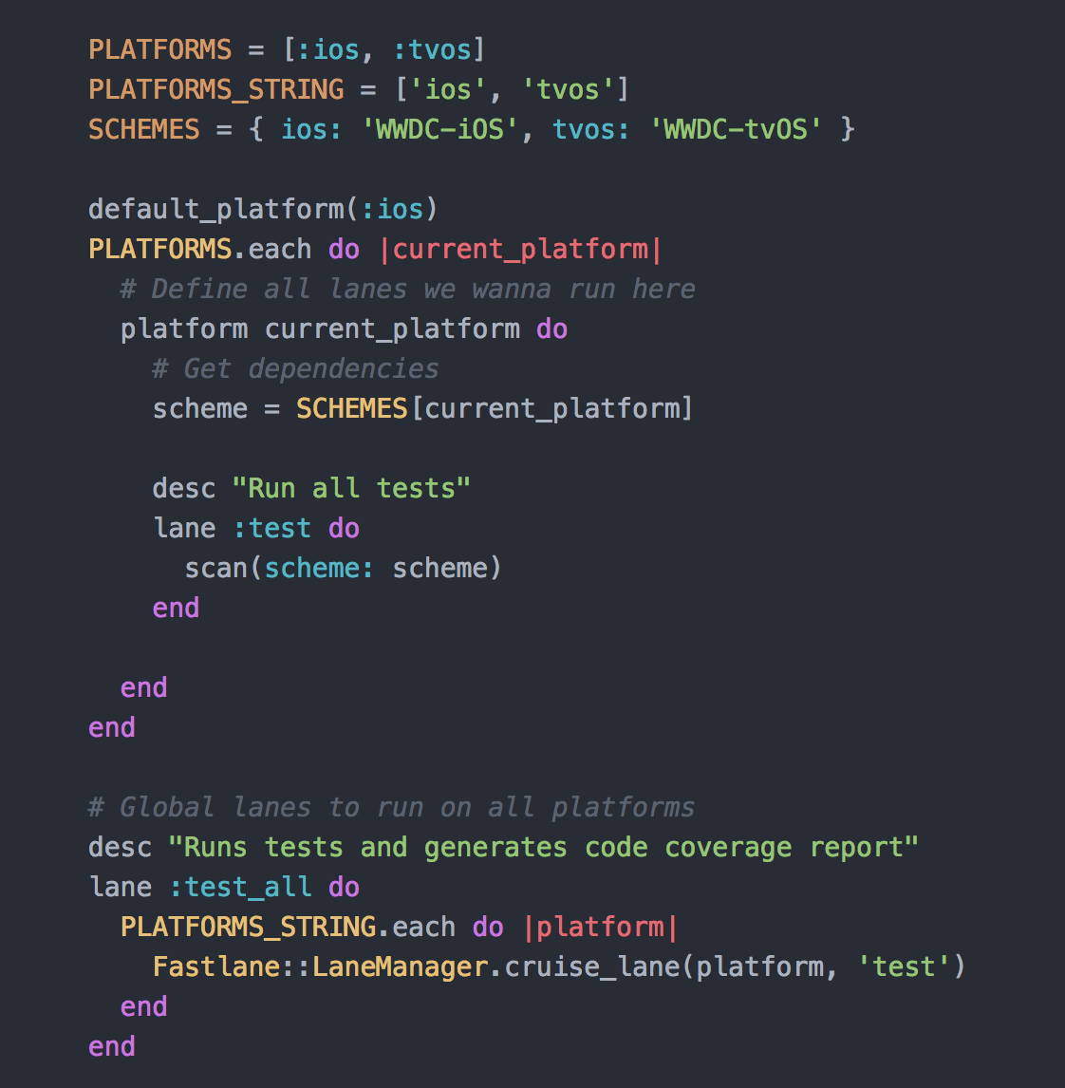

Slide 34
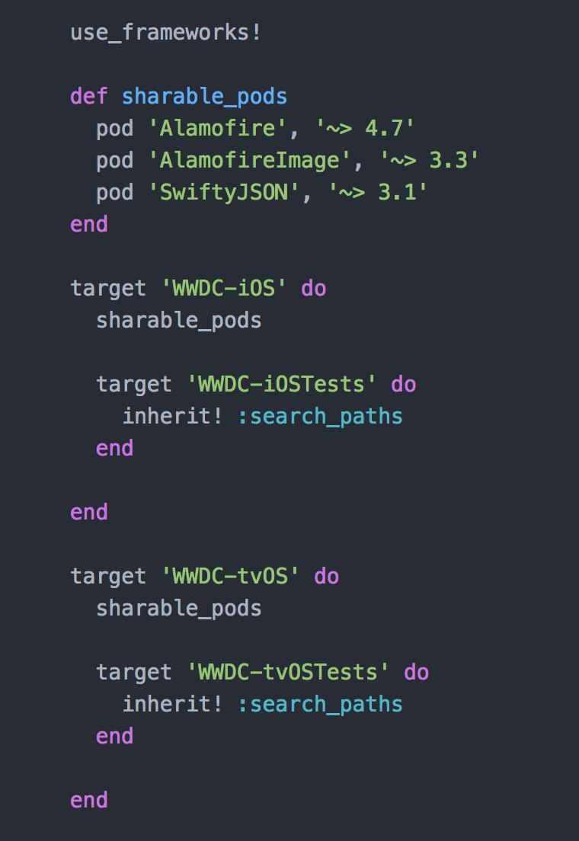
Cocoa pod

Slide 35
Q&A

Slide 36
Thanks for your attention

